Slide 1
REPORTLAB COMPLETE TUTORIAL
How to generate nested frames in pdf file using reportlab:Part 54
TOTAL TECHNOLOGY

Slide 2
o
Outer frame
Inner frame
TOTAL TECHNOLOGY

Slide 3
o
Code is in the next slide:
Outer frame
Inner frame
TOTAL TECHNOLOGY

Slide 4
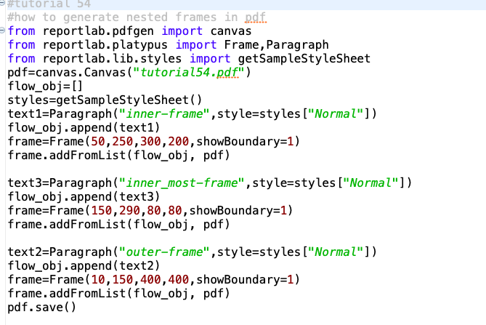
Code:
TOTAL TECHNOLOGY

